Slide 1
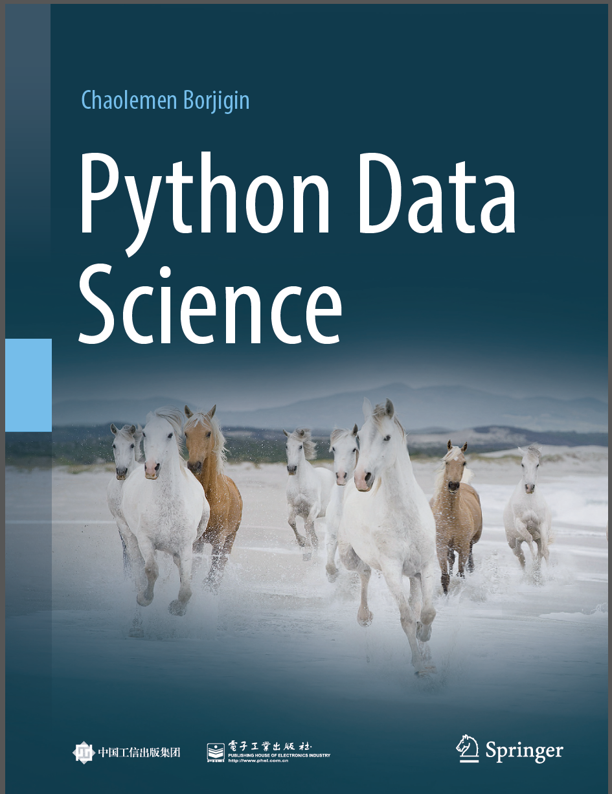
Python Data Science
Chaolemen Borjigin
Renmin University of China
chaolemen@ruc.edu.cn

Slide 2
2.7 If statements
▼ Chapter 2 Basic Python Programming for Data Science
► 2.7 If statements
Chaolemen Borjigin
Renmin University of China
chaolemen@ruc.edu.cn

Slide 3
Summary of this chapter
▼ Chapter 2 Basic Python Programming for Data Science
► 2.7 If statements
2.7.1 Basic syntax
2.7.2 Elif statement
2.7.3 Ternary operators
2.7.4 Advanced syntax

Slide 4
2.7.1 Basic syntax
▼ Chapter 2 Basic Python Programming for Data Science
► 2.7 If statements
In[1]:
a=2
b=3
if(a<b):
print("a is less than b")
else:
print("a is not less than b")
a is less than b

Slide 5
2.7.1 Basic syntax
▼ Chapter 2 Basic Python Programming for Data Science
► 2.7 If statements
In[2]:
if(a<=b):
if(a<b):
print(a)
else:
print(a)
else:
print(b)
2

Slide 6
2.7.2 Elif statement
▼ Chapter 2 Basic Python Programming for Data Science
► 2.7 If statements
In[3]:
if(a<=b):
print(a)
elif(a==b):
print(a)
else:
print(b)
2

Slide 7
2.7.3 Ternary operators
▼ Chapter 2 Basic Python Programming for Data Science
► 2.7 If statements
In[4]:
x=0
Result="Y" if x>0 else "N"
Result
Out[4]:
'N'
In[5]:
x=1
Result="Y" if x>0 else "N"
Result
Out[5]:
'Y'

Slide 8
2.7.4 Advanced syntax
▼ Chapter 2 Basic Python Programming for Data Science
► 2.7 If statements

Slide 9
2.7.4 Advanced syntax
▼ Chapter 2 Basic Python Programming for Data Science
► 2.7 If statements
In[7]:
if(a<=b):
pass
else:
print(b)
In[8]:
import calendar
calendar.isleap(2019)
Out[8]:
False

Slide 10


